Slide 1
Multi-Omic Analysis of Glioblastoma Multiforme
Alan Xu, Christopher Ahn, Mahija Mogalipuvvu, Sankalp Mrutyunjaya
Notes:
Project more
Look at audence, not slides
Active listening at speaker

Slide 2
01.
Introduction
02.
Methods
03.
Results
04.
Discussion
Table of Contents

Slide 3
01.
Introduction

Slide 4
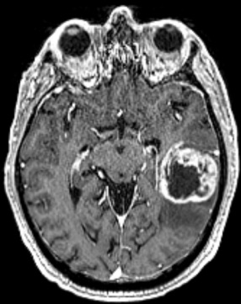
Glioblastoma Multiforme
fast-growing aggressive brain tumor
invades tissues but doesn’t often spread to distant organs
most common malignant brain tumor
49.1% of cases

Slide 5
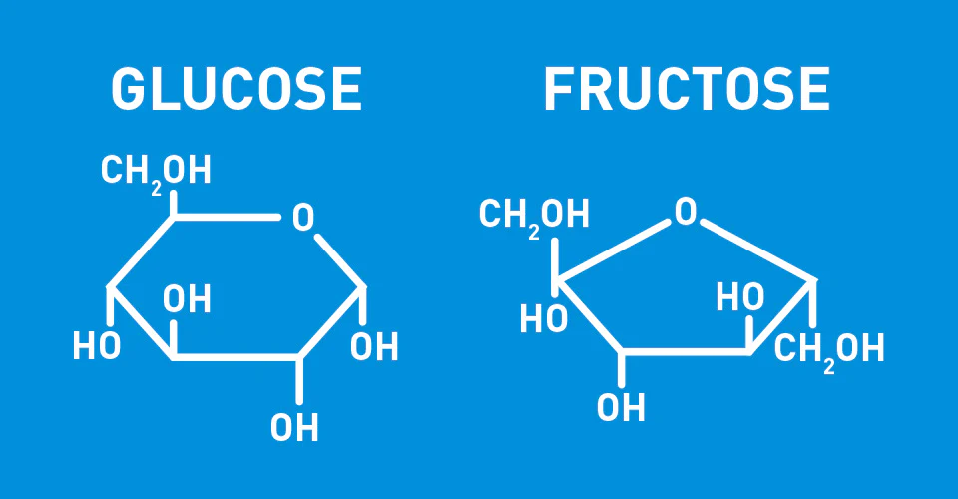
GBM Energy Metabolism
Primary energy source: glucose
Low glucose levels → other energy substrates
Fructose: second most abundant sugar in blood

Slide 6
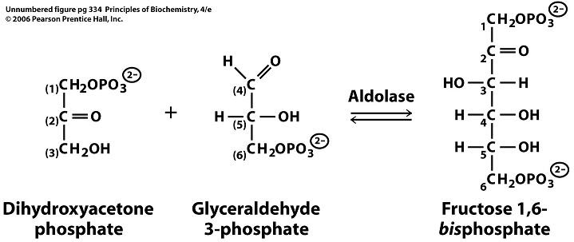
Genes of Interest
ALDOB: Aldolase for fructose 1,6 bisphosphate B
Catalyzes fructose 1,6 bisphosphate to glyceraldehyde 3 phosphate and dihydroxyacetone phosphate
Expressed in low quantities for patients diagnosed with cancer for most malignancies in the human body
Low expression typically yields poorer prognosis

Slide 7
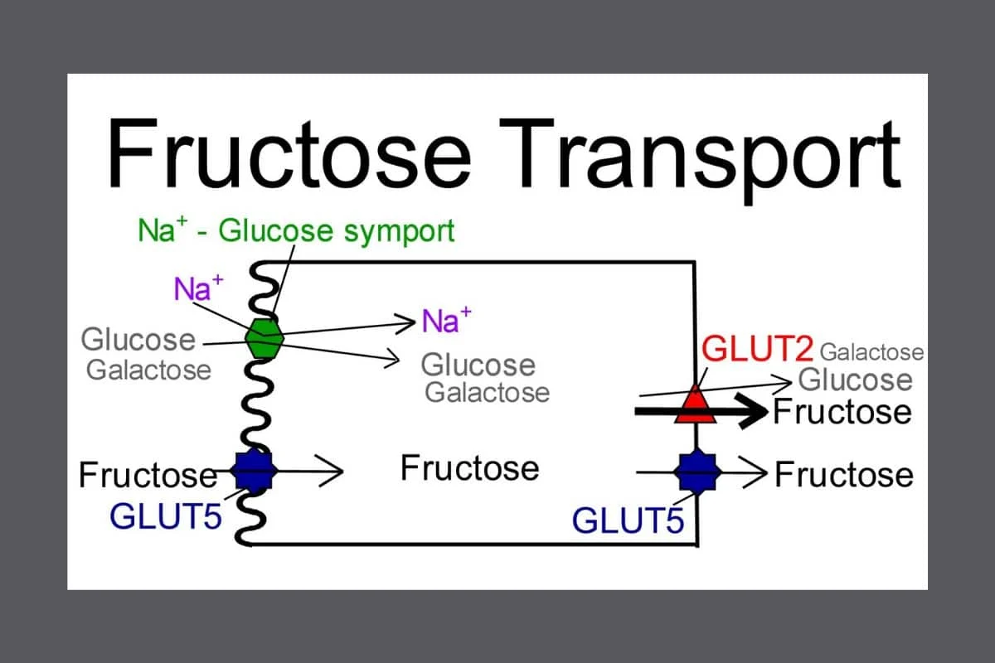
Genes of Interest
SLC2A5: solute carrier family 2 member 5
Mediates uptake of of fructose via GLUT5
Insulin-independent fructose transporter

Slide 8
Hypothesis
Patients with GBM would have a higher mutation rate in genes ALDOB and SLC2A5, correlating to a lower survivability which could be captured by a machine learning model.
Notes:
Rephrase firs

Slide 9
02.
Methods

Slide 10

Oncoplot
10 frequently mutated genes in GBM
Source: TCGA, n = 305
Kaplan-Meier
ALDOB & SLC2A5 genes
Source: TCGA, n = 338
Scatter Plot
Methods
transcription-translation analysis
Source: CPTAC, n = 108

Slide 11
DGE
differential gene analysis
Source : TCGA, n = 371 | Variables: ~ age + vital status
Machine Learning
Methods
classification of patient vital status with RNA/protein expression of ALDOB & SLC2A5
Source: CPTAC, n = 93
Notes:
organize by analysis, list covariants, differentiate between covariants and what we studied
patient sample size, where data came from

Slide 12
03.
Results
Notes:
disconnect between hypothesis and plots done-
be more clear which omic analyses so there is flow
splitting by omic expression
Looking at overall expression and seeing if our genes pop up
Clarify overarching narrative
Consistency between title of graphs- top right, bold, larger

Slide 13
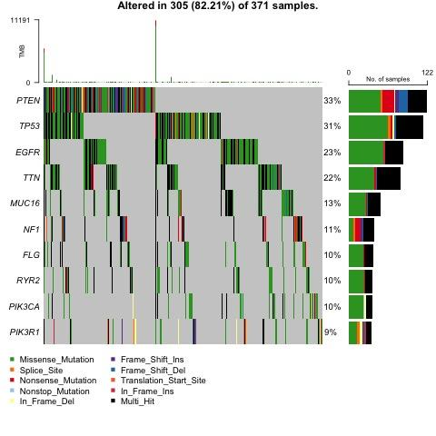
Oncoplot for GBM Patients

Slide 14
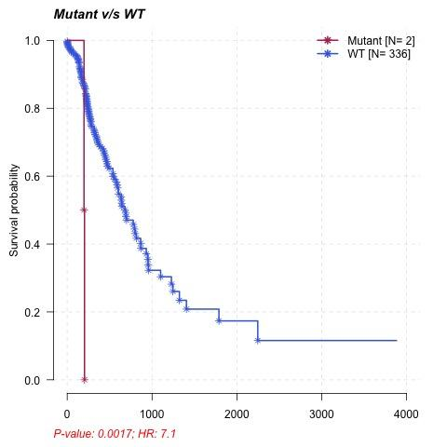
Kaplan-Meier plot for ALDOB

Slide 15
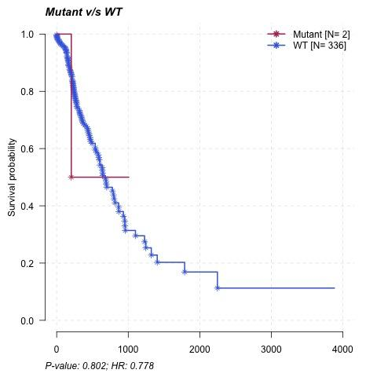
Kaplan-Meier plot for SLC2A5

Slide 16
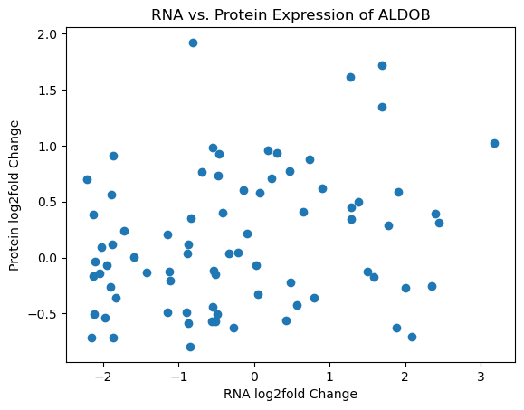
Scatterplot of RNA vs. Protein Expression of ALDOB

Slide 17
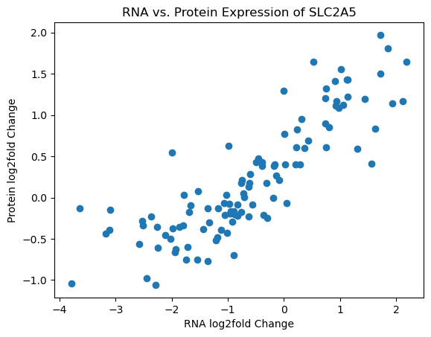
Scatterplot of RNA vs. Protein Expression of SLC2A5

Slide 18
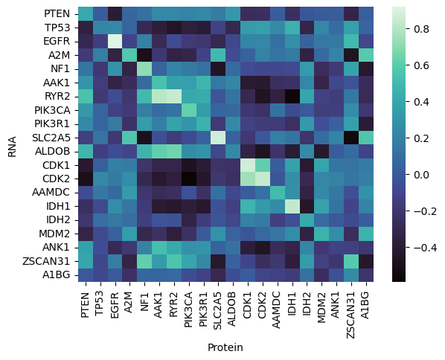
Heatmap for GBM Patients

Slide 19
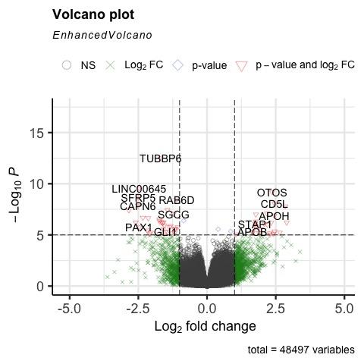
Volcano Plot
Down-regulated RNA Count for dead patients
Up-regulated RNA Count for alive patients
Notes:
Did plot by vital status, not age
upregulated /downregualted with respect to what? Vital status
Dont need numbers labeling, add gene names maybe

Slide 20
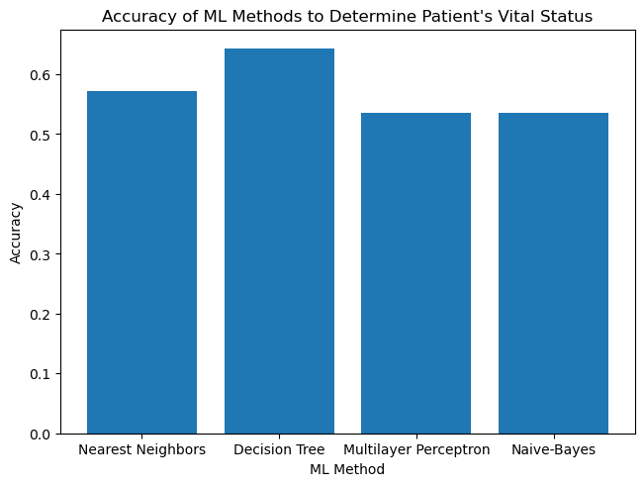
Notes:
THIS IS DONE with protein & RNA expression of ALDOB and SLC2A5
Vital status vs. recurrence- not the same
Why are we predicting vital status- vital status is indication of severity

Slide 21
04.
Discussion

Slide 22
General Conclusions
hypothesis was not supported
ALDOB & SLC2A5: not significant indicator of survivability of GBM patients
weak mRNA-protein correlation ALDOB gene
association between the ALDOB gene and the AAK1, RYR2 and NF1 genes
most accurate machine learning method: decision tree
Notes:
Unexpected sample size and hten we pivoted-
Shouldnt be translation
results: do some anlaysis
discussion: restatement, connect to ltierature
Restate hypothesis

Slide 23
Future Direction
replicate experiments
correlation between ALDOB, RYR2, NF1
increase sample size
control for more variables
more significant results
regulatory mechanisms
Notes:
Disconnected
Age of patient doesnt flow- how does it connect to what we found
Other future directions
Regulatory effect of aldo on other genesb- heatmap correlaiton
Introduce genes- ryr2, nf1, aak1 abt function brief
Importance of research- clinical significance
Vital status?

Slide 24
References
Chen, C., Zhang, Z., Liu, C., Wang, B., Liu, P., Fang, S., Yang, F., You, Y., & Li, X. (2022). Atf4-dependent fructolysis fuels growth of glioblastoma multiforme. Nature Communications, 13(1). https://doi.org/10.1038/s41467-022-33859-9
Carlsson, S. K., Brothers, S. P., & Wahlestedt, C. (2014). Emerging treatment strategies for glioblastoma multiforme. EMBO molecular medicine, 6(11), 1359–1370. https://doi.org/10.15252/emmm.201302627
Esposito, G., Imperato, M. R., Ieno, L., Sorvillo, R., Benigno, V., Parenti, G., Parini, R., Vitagliano, L., Zagari, A., & Salvatore, F. (2010). Hereditary fructose intolerance: functional study of two novel ALDOB natural variants and characterization of a partial gene deletion. Human mutation, 31(12), 1294–1303. https://doi.org/10.1002/humu.21359
Hanif, F., Muzaffar, K., Perveen, K., Malhi, S. M., & Simjee, S.hU. (2017). Glioblastoma Multiforme: A Review of its Epidemiology and Pathogenesis through Clinical Presentation and Treatment. Asian Pacific journal of cancer prevention : APJCP, 18(1), 3–9. https://doi.org/10.22034/APJCP.2017.18.1.3
Hannou, S. A., Haslam, D. E., McKeown, N. M., & Herman, M. A. (2018). Fructose metabolism and metabolic disease. Journal of Clinical Investigation, 128(2), 545–555. https://doi.org/10.1172/jci96702
Hegi, M. E., Diserens, A.-C., Gorlia, T., Hamou, M.-F., de Tribolet, N., Weller, M., Kros, J. M., Hainfellner, J. A., Mason, W., Mariani, L., Bromberg, J. E. C., Hau, P., Mirimanoff, R. O., Cairncross, J. G., Janzer, R. C., & Stupp, R. (2005). MGMT Gene Silencing and Benefit from Temozolomide in Glioblastoma. New England Journal of Medicine, 352(10), 997–1003. https://doi.org/10.1056/nejmoa043331
Hopkins, B. D., Hodakoski, C., Barrows, D., Mense, S. M., & Parsons, R. E. (2014). PTEN function: the long and the short of it. Trends in biochemical sciences, 39(4), 183–190. https://doi.org/10.1016/j.tibs.2014.02.006
Koussounadis, A., Langdon, S. P., Um, I. H., Harrison, D. J., & Smith, V. A. (2015). Relationship between differentially expressed mrna and mrna-protein correlations in a xenograft model system. Scientific Reports, 5(1). https://doi.org/10.1038/srep10775
Nelson, J. S., Burchfiel, C. M., Fekedulegn, D., & Andrew, M. E. (2012). Potential risk factors for incident glioblastoma multiforme: the Honolulu Heart Program and Honolulu-Asia Aging Study. Journal of neuro-oncology, 109(2), 315–321. https://doi.org/10.1007/s11060-012-0895-3
Yang, JM., Schiapparelli, P., Nguyen, HN. et al. Characterization of PTEN mutations in brain cancer reveals that pten mono-ubiquitination promotes protein stability and nuclear localization. Oncogene 36, 3673–3685 (2017). https://doi.org/10.1038/onc.2016.493

